Slide 1



Slide 2
Strenuous Automata
Strenuous Automata is an application that is intended towards learning in way that is more perceivable by me

Slide 3
App Architecture
Strenuous Automata.
CYKAlgorithmLib
Turing Subtractor

Slide 4

CYK Algorithm
Turing Subtractor
Components

Slide 5


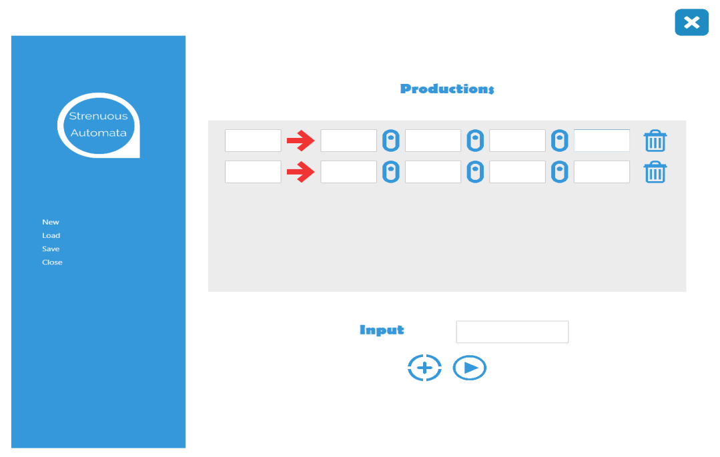

CYK Algorithm
To find membership of a string in Context Free Grammar, We use the CYK Algorithm. The productions inputted to the set must be in Chomsky Normal Form.

Slide 6


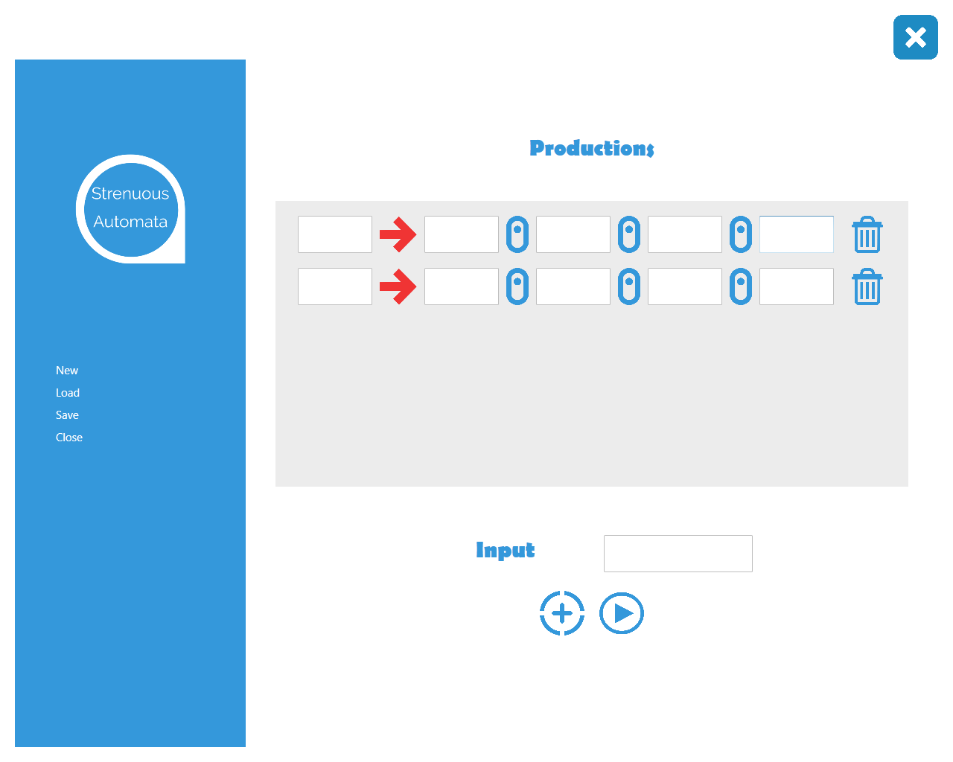


CYK .. Cont. - Classes Involved
Input
Contains methods to manipulate input
Pair
Contains methods to pair inputs
Production
Productions are dealt by this class
Result
This class is responsible putting our results in formatted syntax

Slide 7
Quit Application
Create New
Delete Row
Load Saved Productions
Production Values
Production Key
Save Productions
Enter Input String there
Add New Production
Plot CYK

Slide 8
The Magical Words
public static List<string> ForwardPermute(string input, List<string> output, int subsetSize = 1)
{
// Forward permutation for input 'majid'
// 'm', 'a', 'j', 'i', 'd'
// 'ma', 'aj', 'ji', 'id'
// 'maj', 'aji', 'jid'
// 'maji', 'ajid'
// Collection of such 'Forward Permuted' values is returned
if (subsetSize == input.Length)
{
output.Add(input);
return output;
}
//
for (int i = 0; i <= input.Length - subsetSize; i++)
{
string x = input.Substring(i, subsetSize);
output.Add(x);
}
return ForwardPermute(input, output, subsetSize + 1);
}

Slide 9
The Magical Words
public static List<Production> SearchProductions(string input, List<Production> productions)
{
// input is checked against the matching production rules
// production rules are returned
List<Production> searchedProductions = new List<Production>();
foreach (var production in productions)
{
foreach (var value in production.values)
{
if (value == input)
{
searchedProductions.Add(production);
}
}
}
return searchedProductions;
}

Slide 10
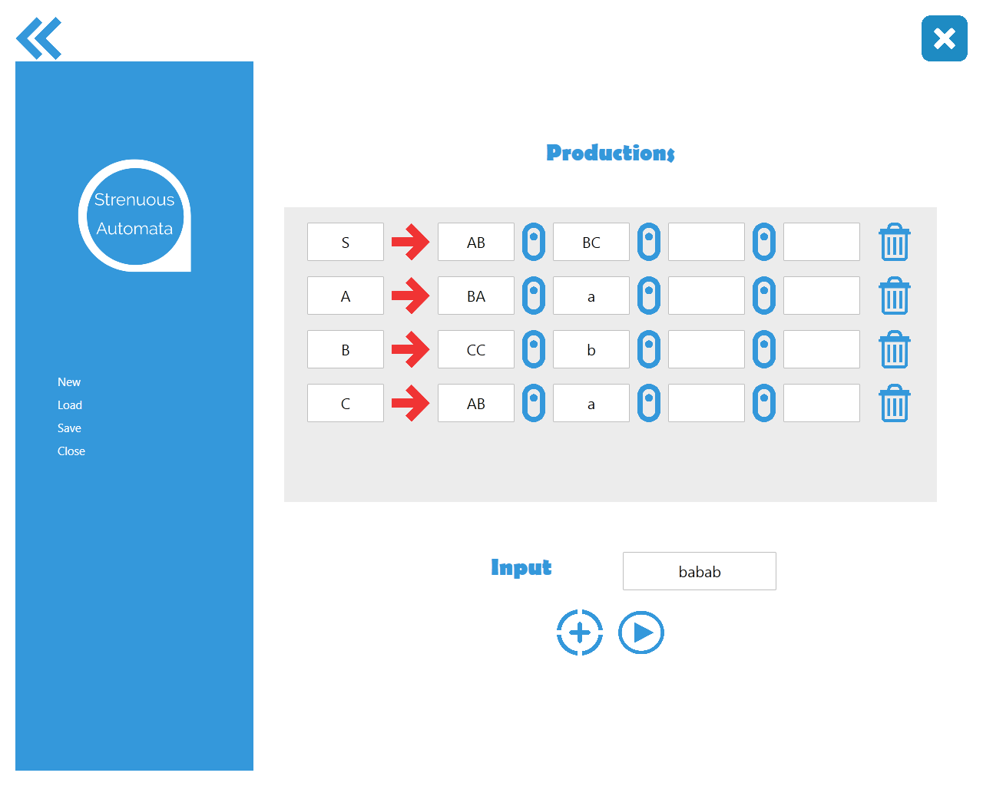
CYK .. Cont - Images

Slide 11
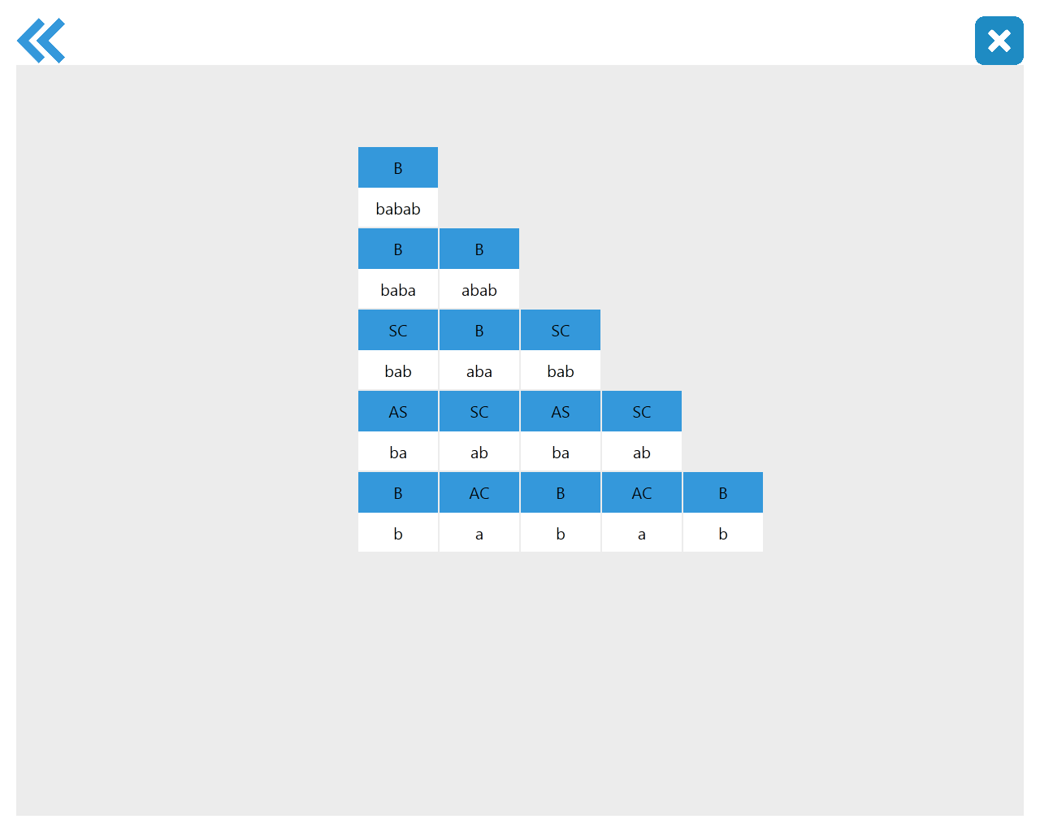
CYK .. Cont - Images

Slide 12

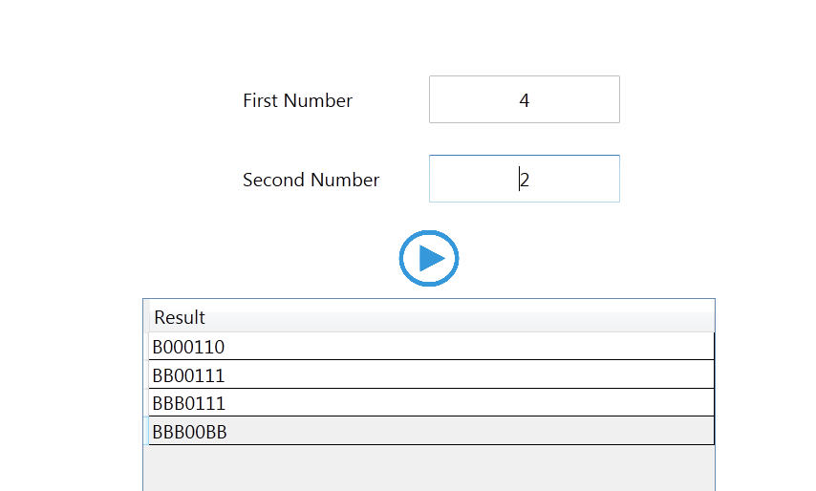
Turing Subtractor
This section of the application is intended to subtract two numbers in case if and only if the first operand is either greater than or equal to the second operand. No negative answer is produced rather we would see a ‘0’ as a result.

Slide 13
Turing Sub.. Cont. - Classes Involved
Subtractor
Contains just two static methods to perform operation on the numbers

Slide 14
Turing .. Cont - Images

Slide 15
The Magical Words
public static char[] GetCharArray(int firstNum, int secondNum)
{
int size = firstNum + secondNum + 1;
char[] array = new char[size];
for (int i = 0; i < size; i++)
{
array[i] = '0';
}
array[firstNum] = '1';
return array;
}

Slide 16
Source Code
https://www.github.com/MajidAliKhanQuaid/WPF-Automata

Slide 17

Thanks

